Slide 1
Module 2 Security Mechanisms
Section 1 – Security Components
June 2018

Slide 2
.
Part 1 – Authentication Mechanisms
Learning Objectives
Understand basic Authentication structures likes SID and Token
Understand the mechanism governing Authentication

Slide 3
Security Identifiers

Slide 4
Security Identifiers
A security identifier (SID) is a unique value of variable length used to identify a trustee.
Each account has a unique SID issued by an authority, such as a Windows domain controller, and stored in a security database.
The system uses the SID in the access token to identify the user in all subsequent interactions with Windows security.
Notes:
SID Manipulation APIs
AllocateAndInitializeSid
Allocates and initializes a SID with the specified number of subauthorities.
ConvertSidToStringSid
Converts a SID to a string format suitable for display, storage, or transport.
ConvertStringSidToSid
Converts a string-format SID to a valid, functional SID.
CopySid
Copies a source SID to a buffer.
EqualPrefixSid
Tests two SID prefix values for equality. A SID prefix is the entire SID except for the last subauthority value.
EqualSid
Tests two SIDs for equality. They must match exactly to be considered equal.
FreeSid
Frees a previously allocated SID by using the AllocateAndInitializeSid function.
GetLengthSid
Retrieves the length of a SID.
GetSidIdentifierAuthority
Retrieves a pointer to the identifier authority for a SID.
GetSidLengthRequired
Retrieves the size of the buffer required to store a SID with a specified number of subauthorities.
GetSidSubAuthority
Retrieves a pointer to a specified subauthority in a SID.
GetSidSubAuthorityCount
Retrieves the number of subauthorities in a SID.
InitializeSid
Initializes a SID structure.
IsValidSid
Tests the validity of a SID by verifying that the revision number is within a known range and that the number of subauthorities is less than the maximum.
LookupAccountName
Retrieves the SID that corresponds to a specified account name.
LookupAccountSid
Retrieves the account name that corresponds to a specified SID.

Slide 5
SID structure
General form (high level)
Rev.
Authority
Authority dependant list of DWORDs (32 bis words)
Binary form
Rev.
Sub Cnt
Authority Identifier
SubAuth 1
SubAuth 2
SubAuth 3
0
1
2
8
12
16
20
String form
S-<Rev.>-<Authority>-<SubAuth.1>-…-<SubAuth.n>

Slide 6
Common Authorities
0 => Null Authority
1 => World Authority
2 => Local Authority
5 => NT Authority
11 => Microsoft Account Authority
12 => Azure AD Authority
16 => Mandatory labels Authority
80 => Services authority

Slide 7
SID examples
‘Everyone’ SID belongs to the World authority
S-1-1-0
NT Authority SID example
S-1-5-21-2341434390-2243354014-643631106-1005
Azure AD Authority example
S-1-12-1-2490972560-1337630679-3377677194-1269695756
Mandatory label
S-1-16-12288

Slide 8
NT Sub Authorities
SubAuthority : The first DWORD of NT Authority SIDs
S-1-5-21-2341434390-2243354014-643631106-1005
No fixed meaning. Can be:
A pseudo-account
S-1-5-18 => SYSTEM
S-1-5-19 => LocalService
S-1-5-20 => NetworkService
A tag
S-1-5-4 => INTERRACTIVE
A pseudo-group
S-1-5-11 => AUTHENTICATED_USERS
LogonID
S-1-5-5-<HighPart>-<LowPart>

Slide 9
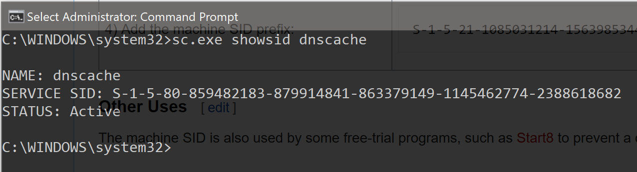
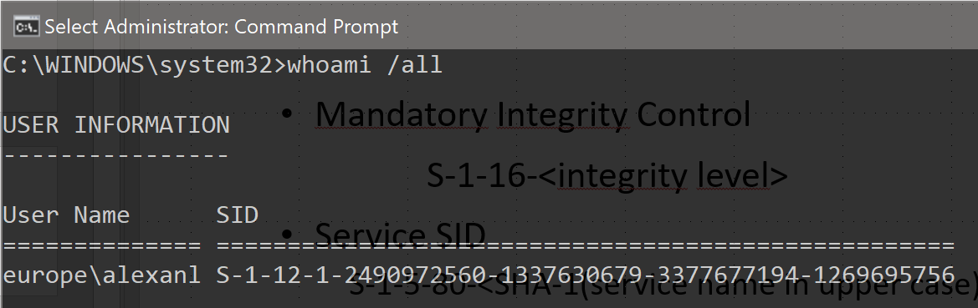
Newer Authorities
Mandatory Integrity Control
S-1-16-<integrity level>
Service SID
S-1-5-80-<SHA-1(service name in upper case)>
Azure AD
S-1-12-1-<GUID of Azure AD user object>

Slide 10
Wellknown SIDs
https://msdn.microsoft.com/en-us/library/windows/desktop/aa379649(v=vs.85).aspx
https://support.microsoft.com/en-us/help/243330/well-known-security-identifiers-in-windows-operating-systems

Slide 11
Access Token

Slide 12
Access Token
Kernel Objects => means managed by the Object Manager
Represent a key to access resources + hold all the security context of the subject accessing a resource
Must be granted SeCreateTokenPrivilege to create token (lsass.exe token has this privilege)

Slide 13
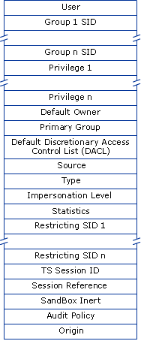
Access Token content
User
The SID for the user’s account.
Groups
A list of SIDs for security groups that include the user.
Privileges
A list of privileges held on the local computer by the user and by the user’s security groups.
Impersonation Level
A value that indicates to what extent a service can adopt the security context of a client represented by this access token.
Type
A value indicating whether the access token is a primary or impersonation token
Claims (device and user)
Additional properties about the user/device that authenticating authority added after authentication.

Slide 14
Token Type
Primary (1) : First token created when the process started
Impersonation (2) : Additional token obtained by the application after authenticating a user
https://msdn.microsoft.com/en-us/library/aa379633(v=vs.90).aspx

Slide 15
Impersonation
Kernel API (PsImpersonateClient())
Sets the current thread’s token to the value passed to API
Must be granted SeImpersonatePrivilege to succeed
Impersonation Levels
SecurityAnonymous
cannot obtain identification information about the client, and it cannot impersonate the client.
SecurityIdentification
can obtain information about the client, such as security identifiers and, but it cannot impersonate the clientprivileges
SecurityImpersonation
can impersonate the client's security context on its local system. The server cannot impersonate the client on remote systems
SecurityDelegation
can impersonate the client's security context on remote systems

Slide 16
Privileges

Slide 17
Privileges
Privileges are special permissions not applying to a specific object but representing a sensitive role or task
Privileges are mostly leveraged on operation with kernel objects like token, files or memory
All privileges are sensitive and should be assigned only when necessary as they can easily disrupt the system
But some are even more sensitive as they directly relate to system security. Next 2 slides are the main privileges related to security.

Slide 18
Privileges
Privilege | Name | Description and risk
SeCreateTokenPrivilege | Create a token object | User can create new token objects with arbitrary groups and permissions. By default, LSASS has it.
SeAssignPrimaryTokenPrivilege | Replace a process level token | User can set the primary token of a process.
SeTcbPrivilege | Act as part of the operating system | User can perform certain high sensitive tasks normally reserved to windows components. Eg: impersonating a user without prior authentication.
SeSecurityPrivilege | Manage auditing and security log | User can set Audit ACL (SACL) on objects. User can also display & clear the security event log
SeTakeOwnershipPrivilege | Take ownership of files or other objects | User can become owner of any files, registry key or other securable object
SeLoadDriverPrivilege | Load and unload device drivers | User can dynamically load and unload device drivers or other code in to kernel mode.
SeBackupPrivilege | Back up files and directories | User can bypass file and directory, registry, and other persistent object permissions for the purposes of backing up the system.
SeRestorePrivilege | Restore files and directories | Users can bypass file, directory, registry, and other persistent objects permissions when restoring backed up files and directories, and determines which users can set any valid security principal as the owner of an object.

Slide 19
Privileges
Privilege | Name | Description and risk
SeDebugPrivilege | Debug programs | User can attach debugger to any process which means ability to read/write memory of these process. This provides complete access to sensitive and critical operating system components.
SeImpersonatePrivilege | Impersonate a client after authentication | Programs which own a valid user token to perform local actions on behalf of this user.
SeTrustedCredManAccessPrivilege | Access credential Manager as a trusted caller | This setting is used by Credential Manager during Backup/Restore. No accounts should have this privilege, as it is only assigned to Winlogon.
SeRelabelPrivilege | Modify an object label | User can modify the security label (MIC) of objects owned by other users
SeDelegateSessionUserImpersonatePrivilege | Obtain an impersonation token for another user in the same session | Programs can obtain an impersonation token of other users who interactively logged on within the same session provided the caller has an impersonation token of the session user.

Slide 20
SSPI & Authentication API

Slide 21
Authentication Model
Authentication functionalities are provided by SP – Security Packages
Authentication : Security Packages may provide zero, one or more AP - Authentication Package. Authentication Package helps LSASS creating sessions for users by authenticating credentials and tell what to put in user’s token
Security Protocols : Security Packages may provide zero, one or more SSP – Security Support Package. SSP implements a security protocol
Security Packages are DLLs loaded by LSASS.exe

Slide 22
How Authentication works in Windows
Authentication is handled by Authentication Packages
DLLs loaded by LSAss.exe
Logon applications like winlogon call a generic interface provided by LSASS. LSASS will dispatch the call to the correct package based on package name or ID
Benefit is that authentication mechanics and secrets storing occur in a process different from logon application.
LSASS.EXE
AP_1.dll
Logon
Application
Dispatch
AP_2.dll
AP_3.dll
Process Boundary

Slide 23
Authentication API
Entry point for logging in users is the LsaLogonUser() API.
Prior to call this API, Logon applications must register using
LsaRegisterLogonProcess()
Applications performing sensitive Authentication tasks like delegation must use this API. Caller must be granted SeTcbPrivilege.
LsaConnectUntrusted()
For applications performing non-sensitive authentication tasks like signing in users with passwords, querying package properties or listing installed packages

Slide 24
Authentication Helper APIs
Windows provides some helper API for applications
Basically, a wrapper around LsaLogonUser() hiding the application registration process
Function | Description
LogonUser | Attempts to log a user on to the local computer.
LogonUserEx | Attempts to log a user on to the local computer. This function is an extended version of the LogonUser function and retrieves information about the logged-on user's security identifier (SID), profile, and quota limits.
LogonUserExExW | The LogonUserExExW function attempts to log a user on to the local computer.

Slide 25
Windows Authentication wrap-up
Application
Logon Applications
LSASS
Kerberos
RPC
sensistive
LsaLogonUser()
SSPI Client Interface
SSPI Server Interface
Dispatch logic
NTLM
non sensistive
Other
Application
LogonUser()
advapi32.dll

Slide 26
Services implemented by Authentication Packages
User Logon
Authenticate user’s credential and tell LSA what to put in the token
LsaApLogonUser() / LsaApLogonUserEx() / LsaApLogonUserEx2()
Logon termination
Notify the package of session termination
LsaApLogonTerminated()
Initialization
Called once by lsass.exe the first time AP is loaded
LsaApInitializePackage()
Direct calls
Allow applications to call packages with a semantic specific to the package. Used for functionalities not described by above APIs
LsaApCallPackage() / LsaApCallPackagePassthrough() / LsaApCallPackageUntrusted()

Slide 27
Security Support Package
Allows an application to use various security models available on a computer or network without changing the interface to the security system.
The SSPI interface is available in kernel mode as well as user mode.

Slide 28
SSPI Functions
Package Management
Functions that list the available security packages and select a package.
Credential Management
Functions that create and work with handles to the credentials of principals.
Context Management
Functions that use credentials handles to create a security context.
Message Support
Functions that use security contexts to ensure message integrity and privacy during message exchanges over the secured connection. Integrity is achieved through message signing and signature verification. Privacy is achieved through message encryption and decryption.

Slide 29
Package Management
SSPI package management functions initiate a security package, enumerate available packages, and query the attributes of a security package. The following SSPI functions provide management services for security packages.
Function | Description
EnumerateSecurityPackages | Lists available security packages and their capabilities.
InitSecurityInterface | Retrieves a pointer to a security support provider (SSP) dispatch table.
QuerySecurityPackageInfo | Retrieves information about a specified security package. This information includes the bounds on sizes of authentication information, credentials, and contexts.

Slide 30
Credential Management APIs
SSPI credential management functions provide a credentials handle, a reference to an opaque security object, for accessing a principal. The security object is opaque because the application has access only to the handle and not to the actual contents of the structure.
A credential handle is a 64-bit value between {0x00000000, 0x00000000} and {0xFFFFFFFF, 0xFFFFFFFE}
Function | Description
AcquireCredentialsHandle (General) | Acquires a handle to the preexisting credentials of a specified principal.
ExportSecurityContext | Exports a security context into a context buffer.
FreeCredentialsHandle | Releases a credential handle and associated resources.
ImportSecurityContext | Imports a security context exported by using ExportSecurityContext into the current process.
QueryCredentialsAttributes | Retrieves the attributes of a credential, such as the name associated with the credential.

Slide 31
Context Management APIs (1/2)
SSPI context management functions create and use security contexts.
In a communication link, the client and server cooperate to create a shared security context. The client and server both use the security context with message support functions to ensure message integrity and privacy during the connection.
Security contexts are opaque security objects. Information in the security context is not available to the application. Context management functions create and use context handles and the security package dereferences the context handle to access its security content.
A context handle is a 64-bit value between {0x00000000, 0x00000000} and {0xFFFFFFFF, 0xFFFFFFFE}.

Slide 32
Context Management APIs (2/2)
Function | Description
AcceptSecurityContext | Used by a server to create a security context based on an opaque message received from a client.
ImpersonateSecurityContext | Impersonates the security context to appear as the client to the system.
CompleteAuthToken | Completes an authentication token. This function is used by protocols, such as DCE, that need to revise the security information after the transport application has updated some message parameters.
DeleteSecurityContext | Frees a security context and associated resources.
InitializeSecurityContext (General) | Used by a client to initiate a security context by generating an opaque message to be passed to a server.
QueryContextAttributes (General) | Enables a transport application to query a security package for certain attributes of a security context.
QuerySecurityContextToken | Obtains the access token for a client security context and uses it directly.
SetContextAttributes | Enables a transport application to set attributes of a security context for a security package. This function is supported only by the Schannel security package.

Slide 33
Message APIs
SSPI message support functions enable an application to transmit and receive tamper-resistant messages and to encrypt and decrypt messages.
These functions work with one or more buffers that contain a message and with a security context created by the context management functions.
The functions' behavior differs based on whether a connection, datagram, or stream context is in use.
Function | Description
DecryptMessage (General) | Decrypts an encrypted message by using the session key from a security context.
EncryptMessage (General) | Encrypts a message by using the session key from a security context.
MakeSignature | Generates a cryptographic checksum of the message, and also includes sequencing information to prevent message loss or insertion.
VerifySignature | Verifies the signature of a message received that was signed by the sender by using the MakeSignature function.

Slide 34
Security Support Provider
A dynamic-link library (DLL) that implements the SSPI by making one or more security packages available to applications.
Each security package provides mappings between an application's SSPI function calls and an actual security model's functions.

Slide 35
SSP Packages Provided by Microsoft
Credential Security Support Provider
CredSSP lets an application delegate the user's credentials from the client to the target server for remote authentication.
Negotiate
When an application calls into SSPI to log on to a network, Negotiate analyzes the request and picks the best SSP to handle the request based on customer-configured security policy.
Microsoft NTLM
Microsoft Kerberos
Digest
SChannel

Slide 36
SAM Database

Slide 37
Security Account Manager
SAM – Security Account Manager
Historical account database for Windows NT based Operating Systems
Still present in the latest Windows builds
On Standalone machines (what is generally called WORKGROUP machine) or domain member machines, SAM is the location where local user, passwords, groups are stored. Database is implemented as a registry key.
On Domain Controllers, SAM is part of the AD-DS services and its database backend is the directory
A internal mechanism maps SAM attributes to AD-DS attributes.
Note : SAM has internal mechanisms to query the directory and consequently, do not use LDAP to access data.

Slide 38
SAM Objects
Domain
Represent the root container of security objects. Domain member and standalone machine have a local domain.
Alias
Local groups.
Group
No sense for local SAM database. On NT4/AD-DS domain controllers, these are the domain groups.
Users
Object representing user accounts.

Slide 39
SAM-R API
RPC Interface listening on Named Pipes and Local Procedure Calls
UUID = {12345778-1234-ABCD-EF00-0123456789AC}
About SAM-R security
The only transport of theses 2 which supports network is Named Pipes
SAM-R does not have its own NP, it shares the one opened by LSA (\\.\pipe\lsass) which has anonymous access.
The SAM access control algorithm can be configured to restrict operations under anonymous context (next slide)
Additionaly, system-wide NamedPipes settings can restrict anonymous access to named pipes

Slide 40
SAM-R Restrict Anonymous access
Goal: avoid anonymous enumerations of users, domains, groups, …
Registry setting
HKEY_LOCAL_MACHINE\SYSTEM\CurrentControlSet\Control\LSA\RestrictAnonymous
When set to a value >= 1, will remove default listing and reading permissions for Anonymous sessions. Anonymous access can be enabled by defining explicit permissions
Setting read by other security services. Not only SAM.
Variant
HKEY_LOCAL_MACHINE\SYSTEM\CurrentControlSet\Control\LSA\RestrictAnonymousSAM
Applies only to SAM-R

Slide 41
SAM-R Restrict Remote access
Restrict access to SAM-R from the network
New feature on Windows 10 1607 and Windows Server 2016 (back ported to earlier SKUs under some conditions)
Allow defining custom permissions for remote accesses to SAM-R. Default permissions
For DC machines : no additional access check. Maintained for compatibility reasons
For non-DC machines : Grants Read permission only to members of the local (built-in) Administrators group.
Audit mode available to avoid production issue
See https://docs.microsoft.com/en-us/windows/security/threat-protection/security-policy-settings/network-access-restrict-clients-allowed-to-make-remote-sam-calls

Slide 42
Restricting anonymous access to named pipes
Named Pipes that can be accessed anonymously
HKLM\System\CurrentControlSet\Services\LanManServer\Parameters\NullSessionPipes
File server feature (ie: access check is performed before the target service is activated)
Contains list of named pipes which will accept anonymous access
Needs the next setting
Restrict anonymous access to Named Pipes and Shares
HKEY_LOCAL_MACHINE\System\CurrentControlSet\Services\LanManServer\Parameters\RestrictNullSessAccess
Also fileserver feature
Activates the restriction

Slide 43
.
Part 2 – Access Control Mechanisms
Learning Objectives:
Understand the most common access control mechanisms in Windows

Slide 44
Access Control

Slide 45
Discretionary Access Control
Key notion to understand : Ownership
Why Discretionary ?
A subject with a certain access permission (owner) is capable of passing that permission (perhaps indirectly) on to any other subject.
Not unique to Windows (eg. Chown/chmod command on Unix/Linux systems)
Generally implemented as ACLs (Access Control Lists) and ACEs (Access Control Entry)

Slide 46
Access Control Lists
Exists in two flavors
DACL => mainly used for access control
SACL => mainly used for audit
Security Descriptors contains:
Security identifiers (SIDs) for the owner and primary group of an object.
A DACL that specifies the access rights allowed or denied to particular users or groups.
A SACL that specifies the types of access attempts that generate audit records for the object.
A set of control bits that qualify the meaning of a security descriptor or its individual members.
See https://msdn.microsoft.com/en-us/library/windows/desktop/aa379561(v=vs.85).aspx

Slide 47
ACE ordering during evaluation
All explicit ACEs are placed in a group before any inherited ACEs.
Within the group of explicit ACEs, access-denied ACEs are placed before access-allowed ACEs.
Inherited ACEs are placed in the order in which they are inherited. ACEs inherited from the child object's parent come first, then ACEs inherited from the grandparent, and so on up the tree of objects.
For each level of inherited ACEs, access-denied ACEs are placed before access-allowed ACEs.

Slide 48
ACE Components
Trustee’s SID
a SID that identifies the user, group, or logon session to which the new ACE allows access
Flags
Control Inheritance (Containers Inherit, Object Inherit, …)
AccessMask
Actual permissions
ObjectType (optional)
GUID structure that identifies the type of object, property set, or property protected by the new ACE.
InheritedObjectTypeGuid (optional)
a GUID structure that identifies the type of object that can inherit the new ACE.

Slide 49
Mandatory Access Control
Key notion to understand: No Ownership
Why Mandatory ?
Operating system constrains the ability of a subject or initiator to access or generally perform some sort of operation on an object or target. Constraints cannot be overridden by users
Not specific to Windows (see SELinux, AppArmor or FreeBSD’s MAC)
Generally implemented as two step process:
Policy tags subjects and ressrouces with certain level of security or certain tag
OS grants or refuse access by comparing the level/tags

Slide 50
Mandatory Integrity Control
Windows defines four integrity levels:
Low (SID: S-1-16-4096)
Medium (SID: S-1-16-8192)
High (SID: S-1-16-12288)
System (SID: S-1-16-16384)
Windows defines 3 policies
SYSTEM_MANDATORY_LABEL_NO_WRITE_UP (1)
Fails when Operation = Write and Level(User)<Level(Resource)
SYSTEM_MANDATORY_LABEL_NO_READ_UP (2)
Fails when Operation = Read and Level(User)<Level(Resource)
SYSTEM_MANDATORY_LABEL_NO_EXECUTE_UP (4)
Fails when Operation = Execute and Level(User)<Level(Resource)

Slide 51
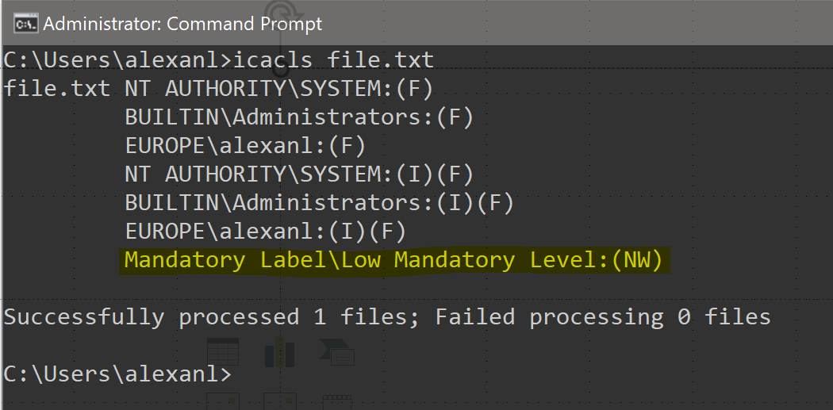
Display a resource’s MIC policy
MIC is implemented as regular ACEs using the MIC Authority
Default level is Medium

Slide 52
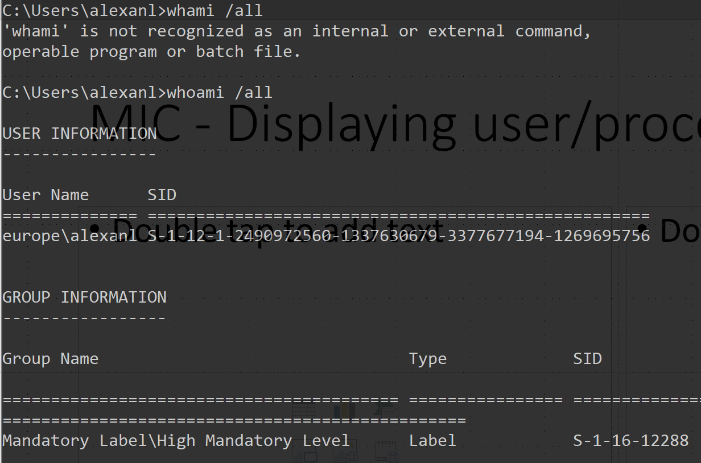
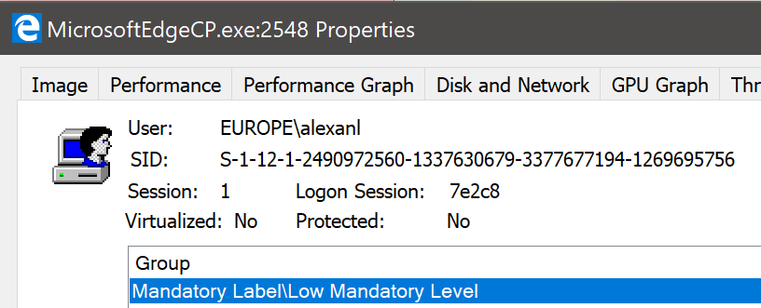
MIC - Displaying user/process current level

Slide 53
Security Descriptors
A security descriptor includes information that specifies the following components of an object's security:
An owner security identifier (SID)
A primary group SID
A discretionary access control list (DACL)
A system access control list (SACL)
Qualifiers for the preceding items

Slide 54
SDDL
Security Descriptor Definition Language
Text representation of Security Descriptor.
O:owner_sid
G:group_sid
D:dacl_flags(string_ace1)(string_ace2)...(string_acen) S:sacl_flags(string_ace1)(string_ace2)...(string_acen)
Well-known SIDs and Permissions are encoded in a 2-letter block
Example
"O:AOG:DAD:(A;;RPWPCCDCLCSWRCWDWOGA;;;S-1-0-0)"

Slide 55
SDDL string representation of ACE
Format: ace_type;ace_flags;rights;object_guid;inherit_object_guid;account_sid;
Fields:
ace_type : Type of the ACE.
ace_flags : Flags in the ACE.
rights: Permission.
object_guid: when permission only applies to certain properties of the object (eg. AD Attributes, extended rights, child object type), this is the GUID of the property
inherit_object_guid: when above is true, type of object which can inherit the permission
account_sid: SID string of the user whom permission applies to.

Slide 56
SDDL ACE Type
Exhaustive list: https://msdn.microsoft.com/en-us/library/windows/desktop/aa374928(v=vs.85).aspx
SDDL type string | Description
"A" | ACE is of type Allow. It will grant access to an object
"D" | ACE is of type Deny. It will block access to an object
"AU" | ACE is of type Audit

Slide 57
SDDL ACE Flags
Exhaustive list: https://msdn.microsoft.com/en-us/library/windows/desktop/aa374928(v=vs.85).aspx
SDDL flags string | Description
"CI" | For container objects. Means child container objects must inherit the permission
"OI" | For container objects. Means child objects must inherit the permission
"NP" | For container objects. No propagation to child objects
"IO" | Applies only to child objects. Not the objects owning the ACL
"ID" | Permission is inherited
"SA" | Success Audit
"FA" | Failure Audit

Slide 58
SDDL Permissions Strings
Exhaustive list: https://msdn.microsoft.com/en-us/library/windows/desktop/aa374928(v=vs.85).aspx
SDDL permission | Access right value
"GA" | GENERIC_ALL
"GR" | GENERIC_READ
"GW" | GENERIC_WRITE
"GX" | GENERIC_EXECUTE
"RC" | READ_CONTROL
"SD" | DELETE
"WD" | Write DACL
"WO" | Write Owner
SDDL permission | Access right value
"FA" | File All Access
"FR" | File Read
"FW" | File Write
"FX" | File Execute
"KA" | Registry Key All Access
"KR" | Registry Key Read
"KW" | Registry Key Write

Slide 59
SDDL Sid Strings
Exhaustive list: https://msdn.microsoft.com/en-us/library/windows/desktop/aa379602(v=vs.85).aspx
SDDL SID string | Account alias and corresponding RID
"AN" | Anonymous logon
"AO" | Account operators
"BA" | Built-in administrators
"BU" | Built-in users. The corresponding RID is DOMAIN_ALIAS_RID_USERS.
"CG" | Creator group
"DA" | Domain administrators
"DC" | Domain computers
"DU" | Domain users
"EA" | Enterprise administrators
"SY" | Local system

Slide 60
.
Part 3 – Audit Mechanisms
Learning Objectives:
Understand the Audit system in Windows

Slide 61
About Security Auditing
Security auditing is a methodical examination and review of activities that may affect the security of a system.
Hundreds of events occur as the Windows operating system and the applications that run on it perform their tasks.
Monitoring these events can provide valuable information to help administrators troubleshoot and investigate security-related activities.

Slide 62
Audit Architecture
User-mode
Application
LsaSS.exe
Event Logger
Security Event Log
User-Mode API
Configuration
User-mode
System Service Dispatcher
Event
Messages
Kernel-mode
Kernel-mode
Component
SRM
Kernel-Mode API

Slide 63
Windows Audit configuration engines
Basic engine
For Windows <= XP/2003
Only few very common categories. Do not allow fine selection of events
GPO configuration under : Security Settings\Local Policies\Audit Policy
Advanced engine
For Windows >= Vista/2008
Detailed categories and sub-categories. Allow fine grained selection of events.
GPO configuration under : Security Settings\Advanced Audit Policy Configuration\System Audit Policies

Slide 64
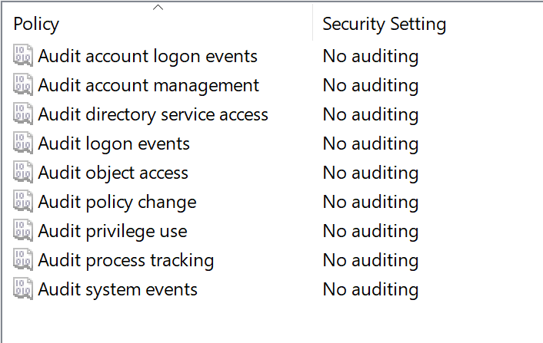
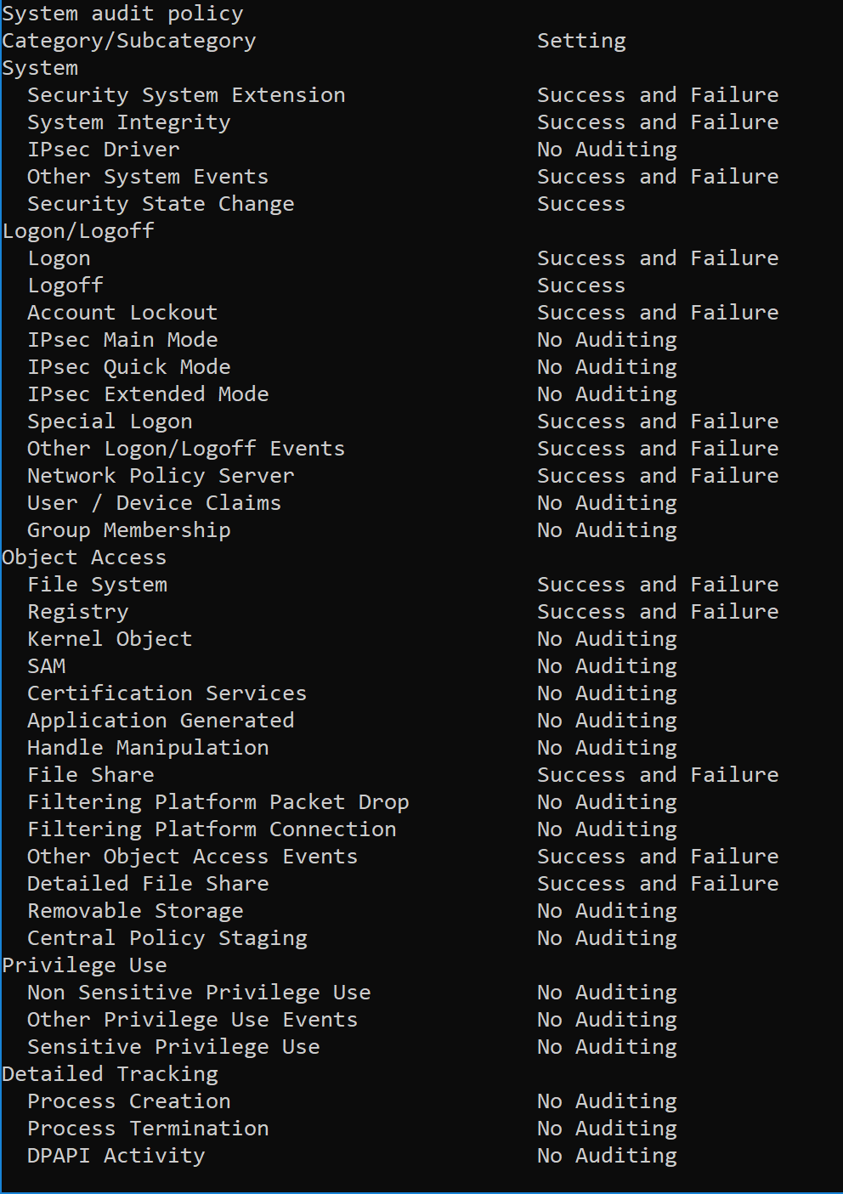
Basic Audit vs. Advanced Audit
Basic
Advanced

Slide 65
Basic Audit vs. Advanced Audit
Basic audit policy settings are not compatible with advanced audit policy settings that are applied by using Group Policy.
When advanced audit policy settings are applied by using Group Policy, the current computer's audit policy settings are cleared before the resulting advanced audit policy settings are applied.
do not use both the basic audit policy settings under Local Policies\Audit Policy and the advanced settings under Security Settings\Advanced Audit Policy Configuration. Using both advanced and basic audit policy settings can cause unexpected results in audit reporting.
be sure to enable the Audit: Force audit policy subcategory settings (Windows Vista or later) to override audit policy category settings policy setting under Local Policies\Security Options.

Slide 66
Global Object Access Auditing
Object auditing depends on per-object SACL (Audit ACL)
=> Can be challenging to audit all objects in System
Global Object access Auditing allows to set a custom default SACL for
Files
In Local or Domain GPO : Security Settings\Advanced Audit Policy Configuration\System Audit Policies\Global Object Access Auditing\File System
Registry
In Local or Domain GPO : Security Settings\Advanced Audit Policy Configuration\System Audit Policies\Global Object Access Auditing\Registry
Enables configuration of a global system access control list (SACL) on the file system/Registry for an entire computer.

Slide 67
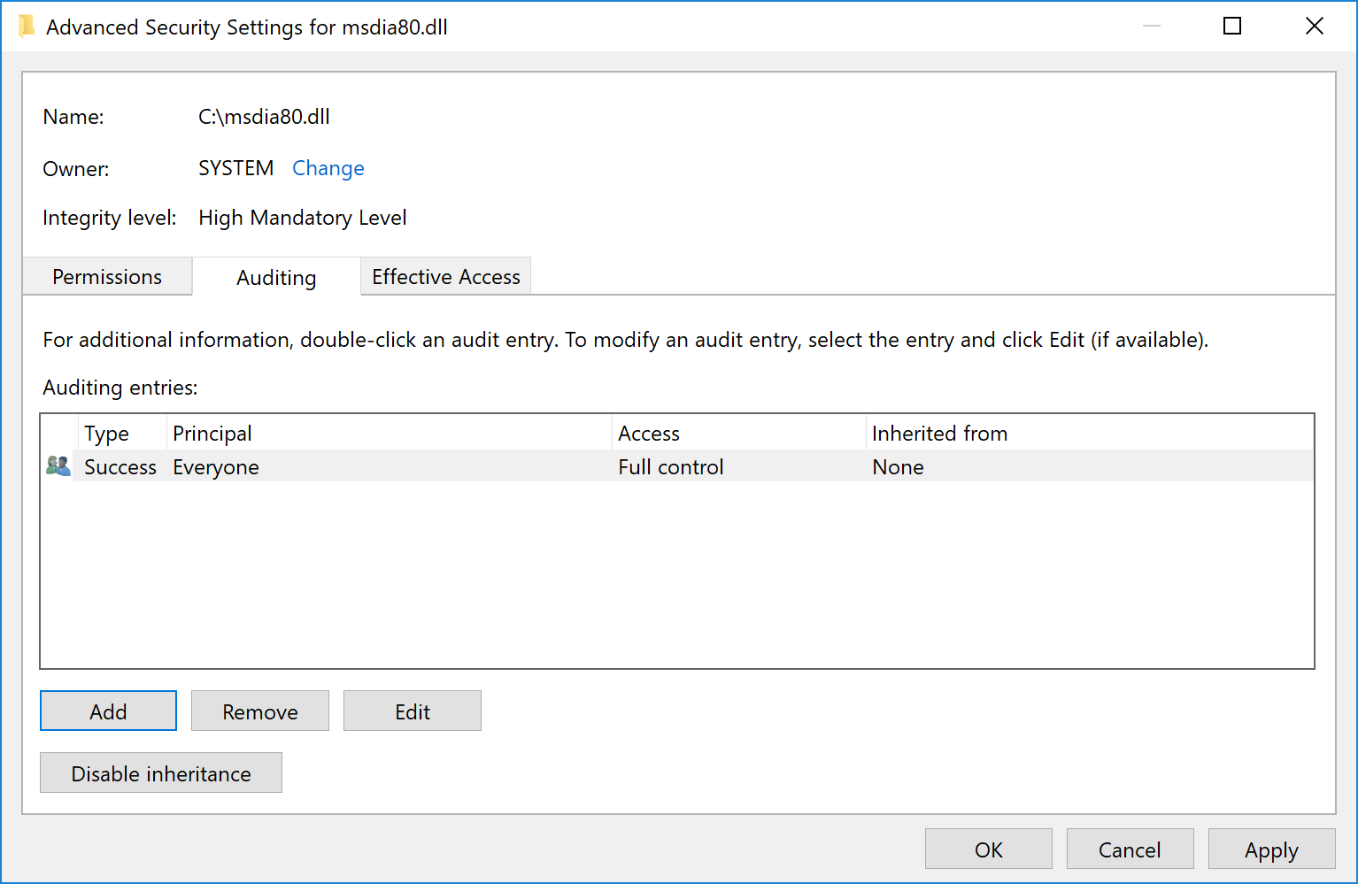
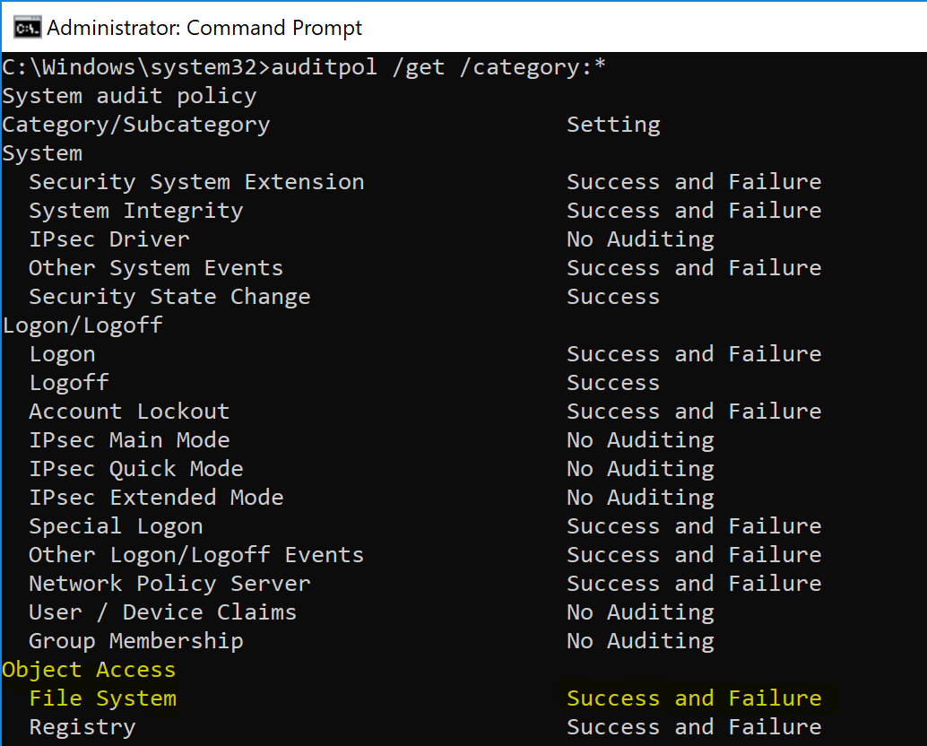
Defining Objects auditing
2-step process
Object must have a SACL (Audit ACL).
Object category must be enabled in the audit policy

Slide 68
Tools for editing Audit policy
auditpol.exe
Dumps the effective audit policy
Edit the current policy
The tool does not write in the GPO. It writes directly in the policy store.
The tool can overwrite settings defined by GPO but next GPO application phase will reset the configuration to the one defined in the GPOs.
GPedit.msc
Edits the local GPO

Slide 69
Third-party applications
Third-party applications can write events in the Security event log
Requires the SeAuditPrivilege privilege (Generate audit events)

